Slide 1
Social Media Engagement Dashboard
A Data Analysis Project
Name: [Suraj Kumar]
Class / Roll No: [Beta 1, 24 EACCS711]

Slide 2
Introduction
This project studies how people engage with brands on social media.
Data is collected from 5 platforms: Instagram, Twitter, YouTube, Facebook and Reddit.
The dataset has 3,499 posts about 10 well known brands.
It shows likes, shares, comments, impressions, sentiment and more for each post.

Slide 3
Objectives
To study social media engagement across different platforms.
To compare the engagement rate of each platform.
To analyse customer sentiment (positive, negative, neutral).
To find the top performing brand.
To find which day of the week gets the most engagement.

Slide 4
About the Dataset
Total rows (posts): 3,499
Platforms: Instagram, Twitter, YouTube, Facebook, Reddit
Brands: Nike, Adidas, Samsung, Apple, Google, Microsoft, Coca-Cola, Pepsi, Toyota, Amazon
Key columns: timestamp, day of week, platform, likes, shares, comments, impressions, engagement rate, sentiment, brand, product

Slide 5
Key Metrics
Total Posts
Total Engagement
3,499
1.39 Crore
Total Impressions
Avg Engagement Rate
17.4 Crore
29.5%

Slide 6
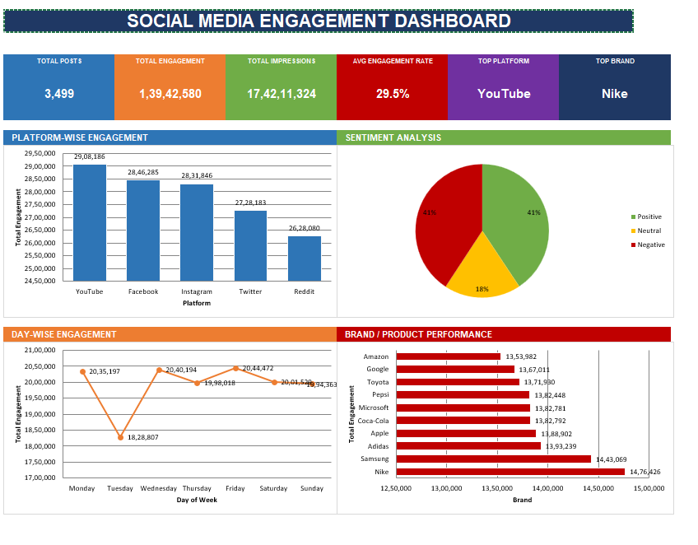
Posts by Platform
Platform | Posts
YouTube | 719
Facebook | 719
Twitter | 708
Instagram | 698
Reddit | 655

Slide 7
Total Engagement by Platform
Platform | Total Engagement
YouTube | 29,08,186
Facebook | 28,46,285
Instagram | 28,31,846
Twitter | 27,28,183
Reddit | 26,28,080

Slide 8
Avg Engagement Rate by Platform
Platform | Avg Engagement Rate
Facebook | 33.3%
Reddit | 33.3%
Instagram | 29.0%
YouTube | 27.3%
Twitter | 25.0%

Slide 9
Sentiment Analysis
Negative
Positive
Neutral
1,426 (40.8%)
1,422 (40.6%)
651 (18.6%)
Positive and negative posts are almost equal in number, showing mixed customer opinion.

Slide 10
Topic Category Distribution
Topic | Number of Posts
Pricing | 623
Returns | 611
Delivery | 591
Marketing | 578
Product | 553
Support | 543

Slide 11
Day-wise Engagement
Day | Total Engagement
Friday | 20,44,472
Monday | 20,35,197
Wednesday | 20,40,194
Saturday | 20,01,529
Thursday | 19,98,018
Sunday | 19,94,363
Tuesday | 18,28,807

Slide 12
Top 5 Brands by Number of Posts
Brand | Posts
Nike | 369
Samsung | 360
Adidas | 360
Coca-Cola | 351
Pepsi | 350

Slide 13
Top 5 Brands by Total Engagement
Brand | Total Engagement
Nike | 14,76,426
Samsung | 14,43,069
Adidas | 13,93,239
Apple | 13,88,902
Coca-Cola | 13,82,792

Slide 14
Dashboard Highlights
Top Platform
Top Brand
YouTube
Nike

Slide 15
Key Insights
Facebook and Reddit have the highest engagement rate, even though YouTube has the most total engagement.
Sentiment is almost equally split between positive and negative posts.
Nike is the most posted about and most engaged brand overall.
Friday shows the highest engagement among all days.
Pricing and Returns are the most discussed topics by users.

Slide 16
Conclusion
This dashboard gives a clear picture of how brands are performing across social media. YouTube leads in overall engagement, Facebook and Reddit lead in engagement rate, and Nike is the top performing brand in this dataset.
Thank You

